Slide 1
Digital Financial Literacy AI Agent
CAPSTONE PROJECT
Presented By: Rijul Yogesh Negi
Student name : Rijul Yogesh Negi
College Name & Department : Guru Nanak Dev Engineering College, Computer Science & Engineering Department

Slide 2
OUTLINE
Problem Statement
Technology used
Wow factor
End users
Result
Conclusion
Git-hub Link
Future scope
IBM Certifications

Slide 3
Problem Statement
The Challenge: Many under-privileged and older individuals struggle to understand and use digital financial tools like UPI, manage personal finances, or avoid online scams. Traditional financial education isn’t always accessible, multilingual, or personalized.
Proposed Solution: A Financial Literacy AI Agent that uses Retrieval-Augmented Generation (RAG), is layered over IBM Granite, and is hosted on IBM Cloud Lite, to deliver real-time, personalized financial guidance.

Slide 4
Technology used
IBM cloud lite services
Natural Language Processing (NLP)
Retrieval Augmented Generation (RAG)
IBM Granite model

Slide 5
IBM cloud services used
IBM Cloud Watsonx AI Studio
IBM Cloud Watsonx AI runtime
IBM Cloud Agent Lab
IBM Granite foundation model

Slide 6
Wow factors
This agent will help the elderly, under privileged, and help those not fully aware of Digital Finance find direction, and protect themselves from financial frauds by making knowledge more accessible and actionable.
Unique features:
Multilingual conversational support for inclusive, localized guidance
Trusted content retrieval from government portals, banks, and educational sites
Personalized financial advice based on user queries and context
Fraud detection education and scam avoidance tips in simple language
Financial term simplification with plain-language explanations

Slide 7
End users
First-time digital finance users People new to online payments, UPI, mobile banking, or personal finance apps.
Low-income or rural populations Individuals with limited access to financial education or formal banking services, especially in underbanked regions.
Elderly individuals Seniors who may struggle with understanding or trusting digital financial tools and need extra guidance.
Students and young adults Especially those beginning to manage money, take loans, or learn about budgeting and savings.
Low-literacy or non-English speakers Users who benefit from multilingual, simplified, and localized explanations.
Financial educators and NGOs Trainers or community workers who can use the agent as a support tool to teach others.

Slide 8
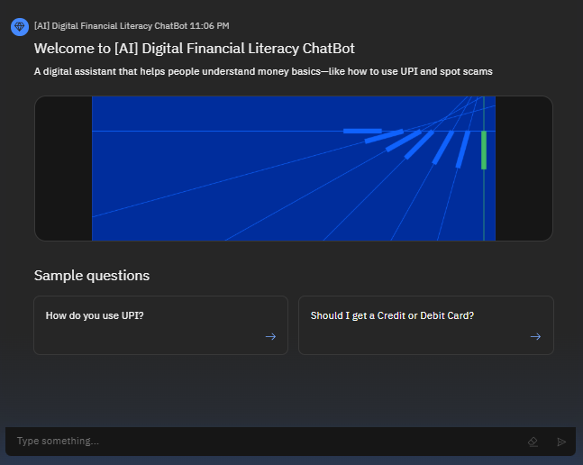
Results

Slide 9
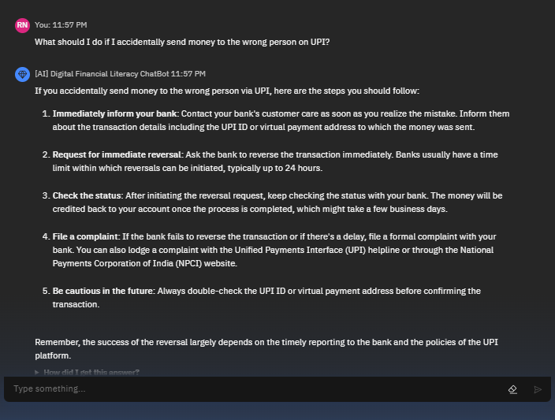
Results

Slide 10
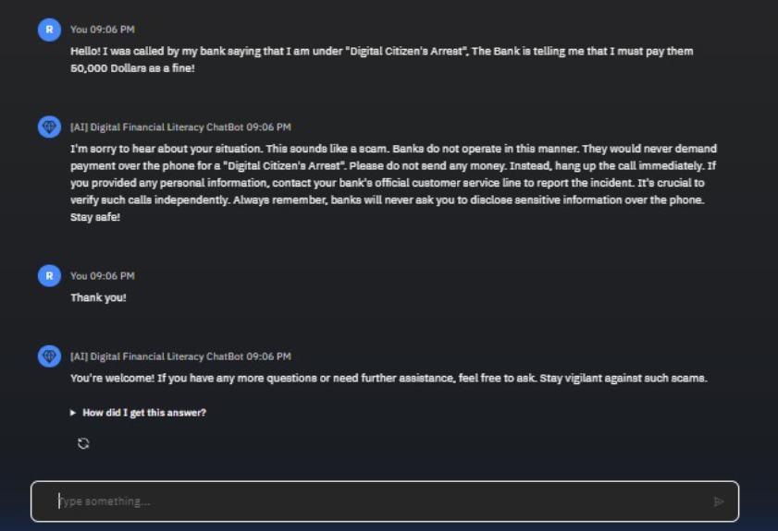
Results

Slide 11
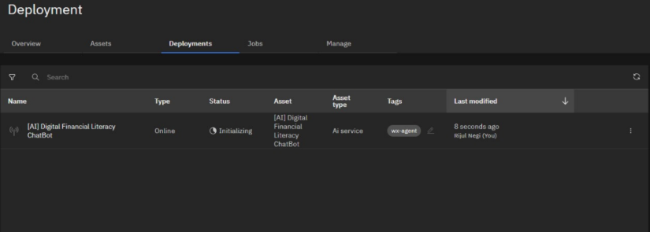
Results
Deployed AI Agent

Slide 12
Conclusion
The agent answers financial questions in simple language and supports users in multiple local languages.
It provides guidance on digital payments, budgeting, loans, and fraud prevention using trusted sources.
Financial Literacy Agents promote inclusion, build digital confidence, and protect users in today’s digital economy.

Slide 13
GitHub Link:- https://github.com/Rijul-Negi/IBM-Cloud-Digital-Financial-Literacy-AI

Slide 14
Future scope
Expand support to more regional languages and dialects for wider accessibility.
Integrate with popular digital wallets and banking apps for seamless in-app assistance.
Incorporate real-time alerts for emerging scams and fraud trends.
Use voice-based interaction for easier access by low-literacy and elderly users.
Leverage user feedback and data to continuously improve AI responses and recommendations.

Slide 15
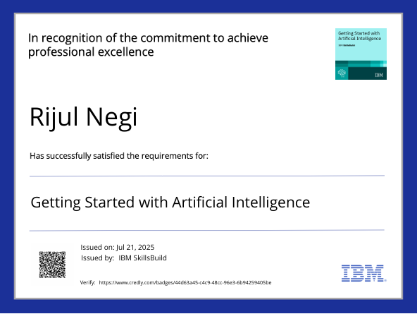
IBM Certifications

Slide 16
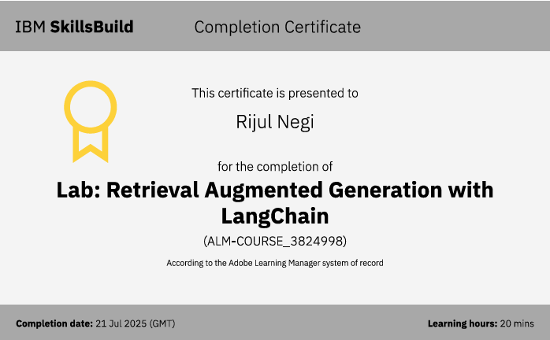

Slide 17
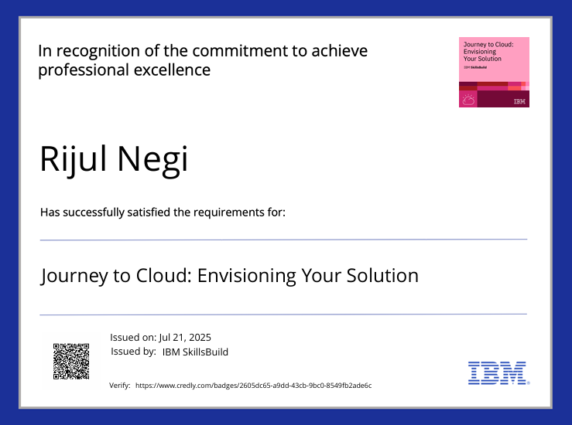

Slide 18
THANK YOU

